Slide 1
Use of LSTM Recurrent Neural Networks for Generating Music
Aditi Awasthi
Department of Computer Science And Engineering
BMS College Of Engineering

Slide 2
Motivation
Neural networks are traditionally used to tackle well-defined problems.
More recently, researchers have started looking for applications regarding pursuits of a more creative nature
In the domain of algorithmic music composition, machine learning-driven systems eliminate the need for carefully handcrafting rules for composition.

Slide 3

Goal
To build a generative model from a deep neural network architecture which creates music with rhythm and complex structure, utilizing all types of notes including dotted notes, longer chords, and rests

Slide 4
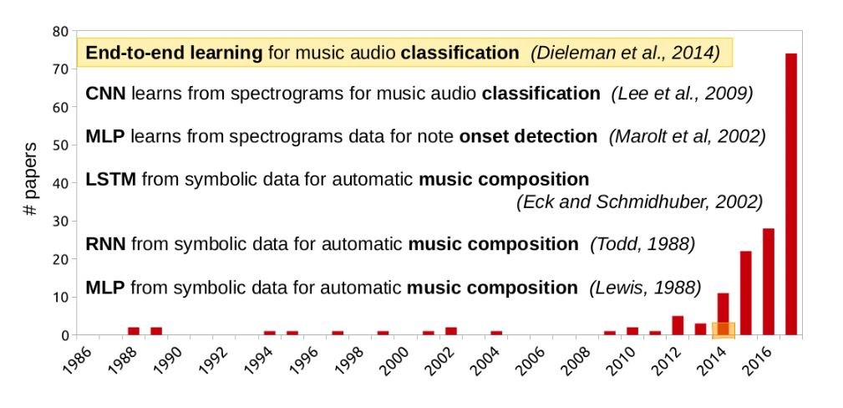
Literature Survey

Slide 5
Background
Markov chains
Multi-layer perceptron
Recurrent Neural Networks
Long Short Term Memory Neural Networks
Alternative approaches like hierarchical temporal memory or principal components analysis.

Slide 6

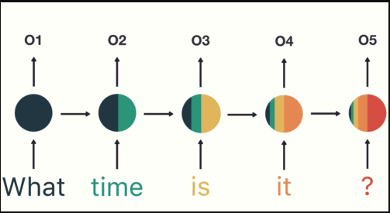
Concept Of Recurrent Neural Networks
The output of each hidden layer is fed back to itself as an additional input.
Each node of the hidden layer receives both the list of inputs from the previous layer and the list of outputs of the current layer in the last time step.
This enables the network to have a simple version of memory, with very minimal overhead.

Slide 7
Concept Of Long Short Term Memory Neural Networks
We can use an LSTM node instead of a normal node. This introduces:
1) Adding a forgetting mechanism
2) Adding a saving mechanism
3) Focusing long-term memory into working memory

Slide 8
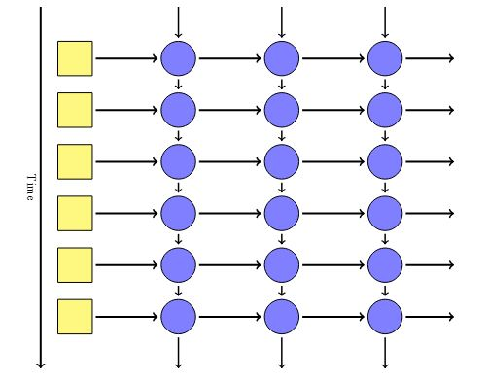
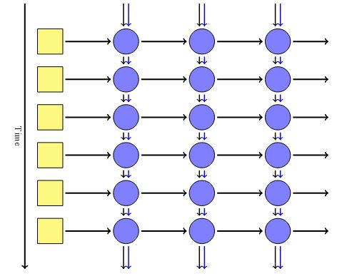

LSTM with respect to the time axis

Slide 9
Major challenges
Representation of music
The kind of data to use
The lack of global coherence or structure

Slide 10
Training data set
Bach's chorales always have four voices (soprano, alto, tenor and bass) that create a rich harmonic progression when played together. The nature of this structure made for good training data for the model.
The dataset is constructed by extracting 8 measures long parts from the MIDI file. The input representation used is piano roll, with the pitch represented as the MIDI note number.

Slide 11
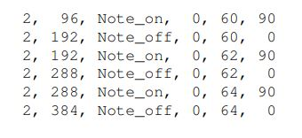
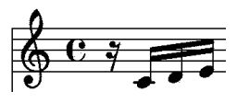
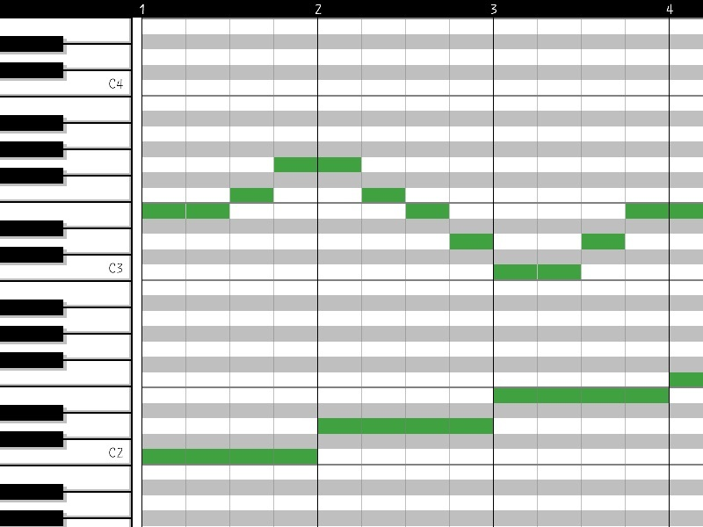
MIDI file and its equivalent scales
Piano Roll representation

Slide 12
Properties of network design
Have some understanding of time signature
Be time-invariant
Be (mostly) note-invariant
Allow multiple notes to be played simultaneously
Allow the same note to be repeated

Slide 13
Implementation
The first part made of two LSTM layers, each with 300 hidden units and recurrent over the time dimension. These layers are in charge of the temporal horizontal aspect, i.e. the relations between notes in a sequence.
The second part is made of two other LSTM layers, with 100 and 50 hidden units, recurrent over the note dimension. These layers are in charge of the harmony vertical aspect, i.e. the relation between simultaneous notes within the same time step.

Slide 14
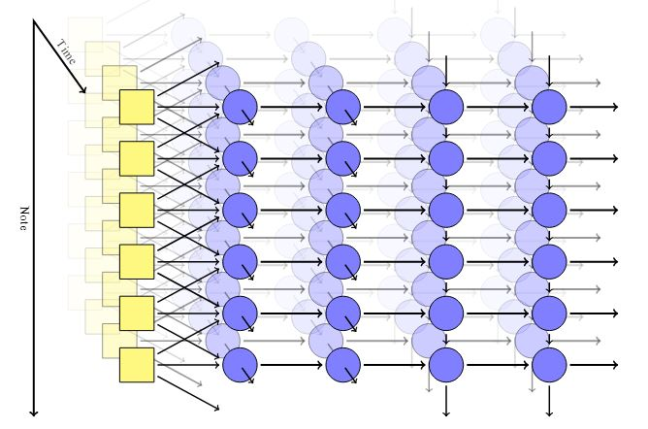
Unfolded architecture of the network

Slide 15

Code for MuseGAN - Siraj Raval

Slide 16
Applications
Conversion of text to speech. Instead of the speech sounding like different words spoken distinctly and simply strung together awkwardly, we can embed cadence into machine-generated sound.
They can construct entire compositions or improvise with us.
Few algorithms can allow the user to generate music with tunable parameters. This will yield more practical benefits for aiding artists, filmmakers, and composers.

Slide 17


On March 21, 2019, Google celebrated German composer and musician Johann Sebastian Bach by creating the first Doodle that uses artificial intelligence to make music.

Slide 18
Conclusion
The model, when used, produced satisfactory results; with the listeners unable to distinguish between true Bach and the music generated by our model with a probability of 78%.
Such innovations can help us find methods to learn musical style and dynamics, harmonize melodies, smooth transitions between disconnected fragments of music and compose from scratch.

Slide 19
References
[1] Lewis, 1988 — “Creation by Refinement: A creativity paradigm for gradient descent learning networks” in International Conference on Neural Networks
[2] Todd, 1989 – “A connectionist approach to algorithmic composition” in Computer Music Journal
[3] Eck & Schmidhuber, 2002 — “Finding temporal structure in music: Blues improvisation with LSTM recurrent networks” in IEEE Workshop on Neural Networks for Signal Processing
[4] Natasha Jaques et al., 2016 – “Generating Music by Fine-Tuning Recurrent Neural Networks with Reinforcement Learning” at Deep Reinforcement Learning Workshop, NIPS
[5] Dieleman et al., 2018 — “The challenge of realistic music generation: modelling raw audio at scale” - arXiv:1806.10474v1
[6] Jean-Pierre Briot et al., 2019 - “Deep Learning Techniques for Music Generation - A Survey” - arXiv:1709.01620v3
[7] Huanru Henry Mao et al., 2018 - “DeepJ: Style-specific music generation” - arXiv:1801.00887v1. [8] Humphrey & Bello, 2012 — “Rethinking automatic chord recognition with convolutional neural networks” in International Conference on Machine Learning and Applications (ICMLA).

Slide 20
Thank you!

